Slide 1


Slide 2
Summary
What did we cover last week?

Slide 3
Math 152 – Lesson 2
Lesson | Topic | Reading
1 | Areas & Distances | 5.1
2 | The Definite Integral | 5.2
3 | Approximate Integration | 7.7
Objectives:
State & understand the definition of the "DEFINITE INTEGRAL“
Express the relationship between the definite integral and Riemann sums
Estimate definite integral given various areas relative to curves
Use Midpoint Rule to estimate definite integrals
Understand & apply the properties of definite integrals

Slide 4

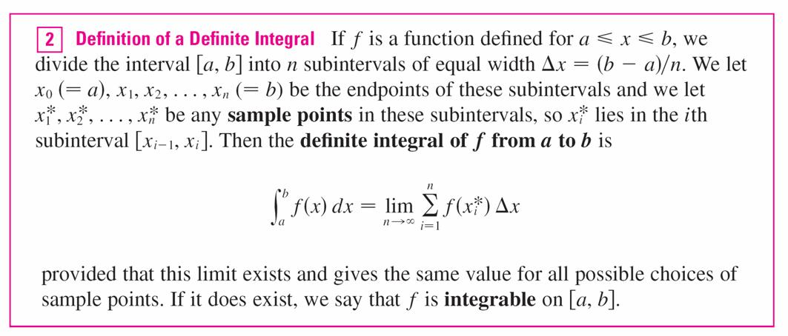
The Definite Integral
We have seen that a limit of the form
Integral
Riemann Sum

Slide 5
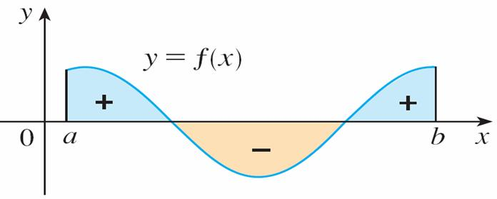
The Definite Integral
Σf (x_{i}*) Δx is an approx to
the net area.
is the net area.

Slide 6
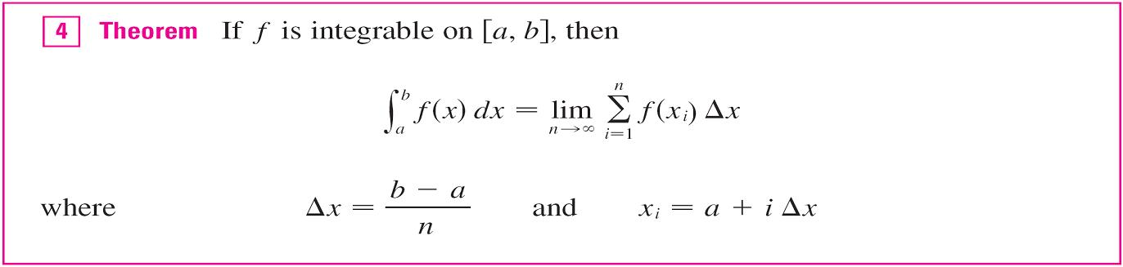
The Definite Integral
To simplify the calculation of the integral we often take the sample points to be right endpoints. Then = x_{i} and the definition of an integral simplifies as follows.

Slide 7
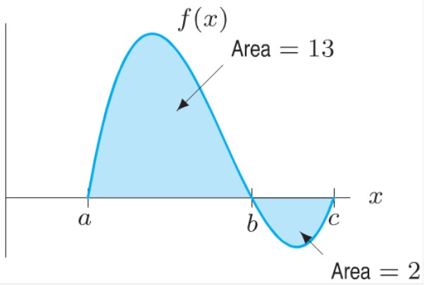
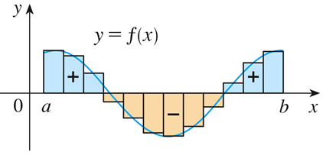

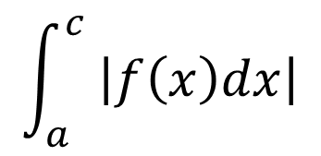



Definite Integral
A definite integral can be interpreted as a net area or the difference of areas
Calculate the following definite integrals:
$$\int_{a}^{b}{f\left(x\right)dx}$$
$$\int_{a}^{c}{f\left(x\right)dx}$$
$$\int_{b}^{c}{f\left(x\right)dx}$$
$$\int_{b}^{a}{f\left(x\right)dx}$$
$$\int_{a}^{c}{ \left|f\left(x\right)dx\right|}$$
Notes:
13, 11, -2,
-13, 15 (what if you move the left bar OUTSIDE the integral?...11)

Slide 8
Evaluating Integrals
When we use these formulas for sums of powers of positive integers.

Slide 9
Evaluating Integrals
The remaining formulas are simple rules for working with sigma notation:

Slide 10
Example
Evaluate the Riemann sum for f (x) = x³ – 6x, taking the sample points to be RHS and a = 0, b = 3, and n = 6.
Hint:

Slide 11
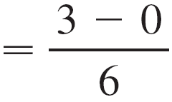
Example Cont’d
Solution:
RHS: x₁ = 0.5, x₂ = 1.0 , x₃ = 1.5, x₄ = 2.0, x₅ = 2.5, and x₆ = 3.0.
So the Riemann sum is:
R₆ = f (x_{i}) Δx = f (0.5) Δx + f (1.0) Δx + f (1.5) Δx + f (2.0) Δx + f (2.5) Δx + f (3.0) Δx
= ½*(–2.875 – 5 – 5.625 – 4 + 0.625 + 9) = –3.9375

Slide 12

Board Work
1. Use the table to estimate $\int_{0}^{12}{f\left(x\right)dx}$
x | 0 | 3 | 6 | 9 | 12
f(x) | 32 | 22 | 15 | 11 | 9
Notes:
5.2, #47: Integral from -1 to 5 of f(x)

Slide 13
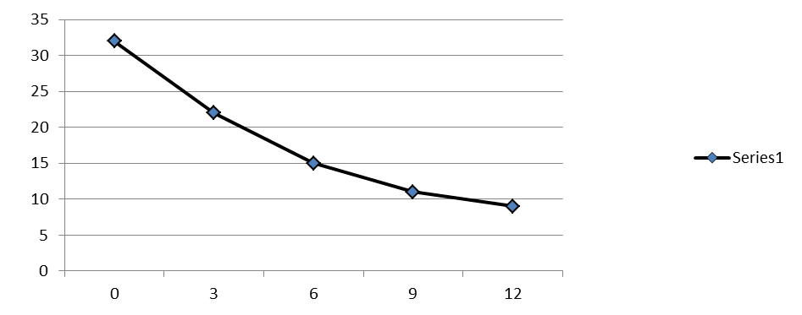
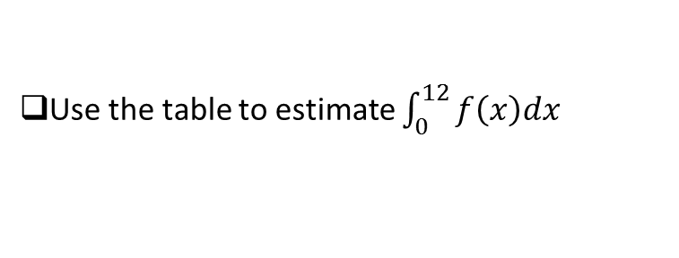
Solution 1
Use the table to estimate $\int_{0}^{12}{f\left(x\right)dx}$
x | 0 | 3 | 6 | 9 | 12
f(x) | 32 | 22 | 15 | 11 | 9
LHS = 3(32 + 22 + 15 + 11)
RHS = 3(22 + 15 + 11 + 9)
Notes:
LHS = 240
RHS = 171
MP = 188 (note: (240 + 171)/2 = 205.5, not 188)
RHS – LHS = 171 – 240 = -69
Note: reference 5.1 #25:
RHS – LHS = 3(22 + 15 + 11 + 9) - 3(32 + 22 + 15 + 11) = 3(9 – 32) = -69
where a = 0, b = 12 & n = 4 (b-a)/n = 3 f(a)=f(0) = 32, f(b)= f(12)=9
R – L = ((b-a)/3)(f(b)-f(a))

Slide 15
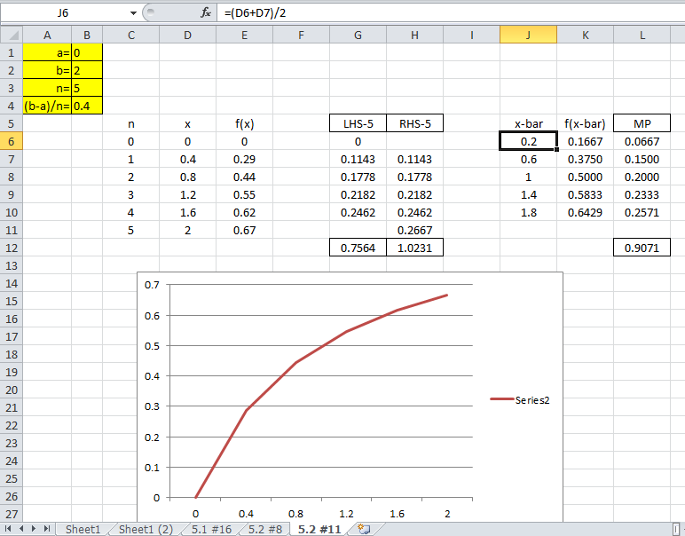

Slide 16
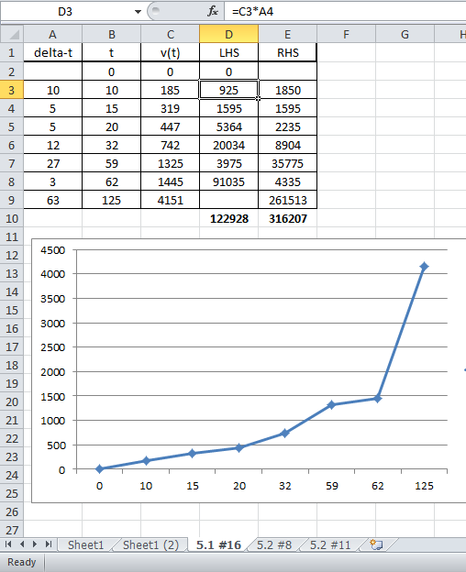

Slide 17
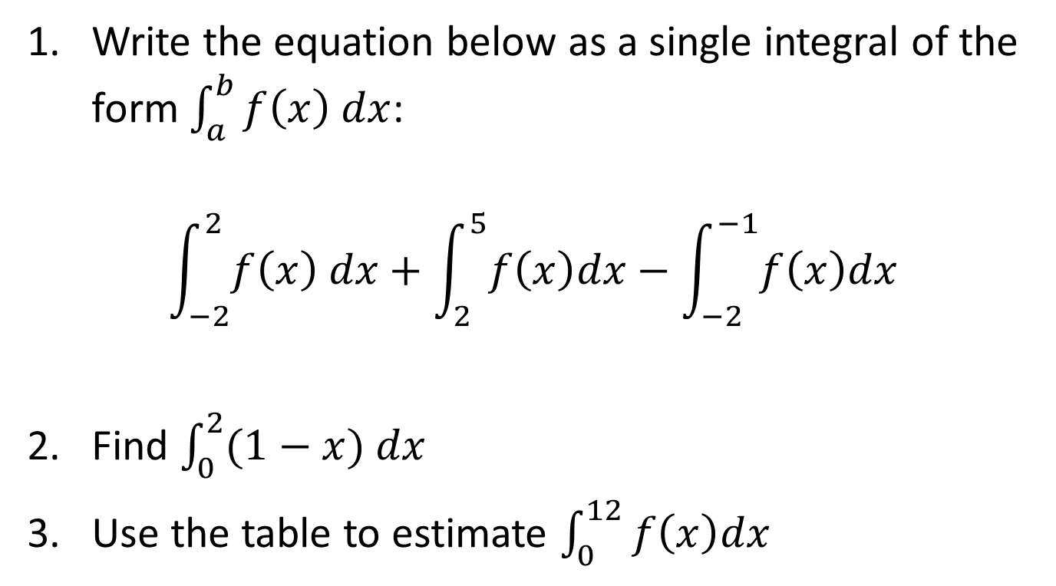
Board Work
Write the equation below as a single integral of the form $\int_{a}^{b}{f\left(x\right) dx}$:
$$\int_{−2}^{2}{f\left(x\right) dx}+\int_{2}^{5}{f\left(x\right)dx}−\int_{−2}^{−1}{f\left(x\right)dx}$$
Find $\int_{0}^{2}{(1−x) dx}$
Use the table to estimate $\int_{0}^{12}{f\left(x\right)dx}$
x | 0 | 3 | 6 | 9 | 12
f(x) | 32 | 22 | 15 | 11 | 9
Notes:
5.2, #47: Integral from -1 to 5 of f(x)

Slide 18
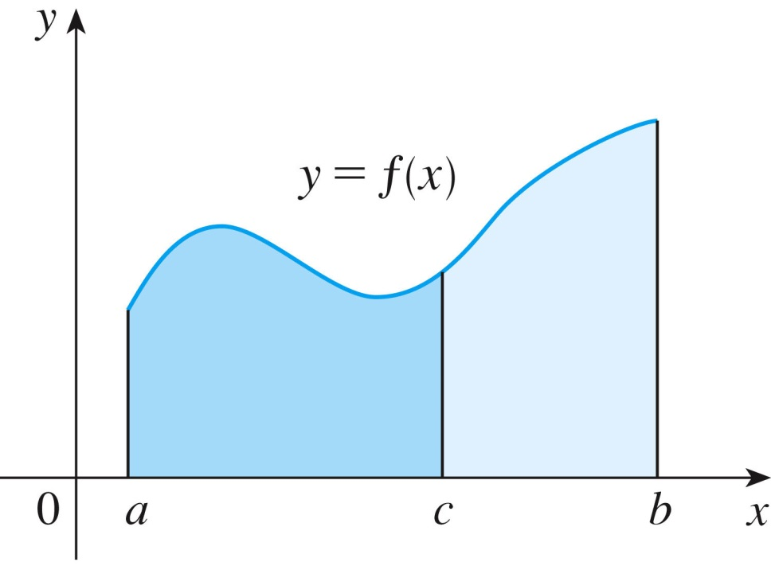
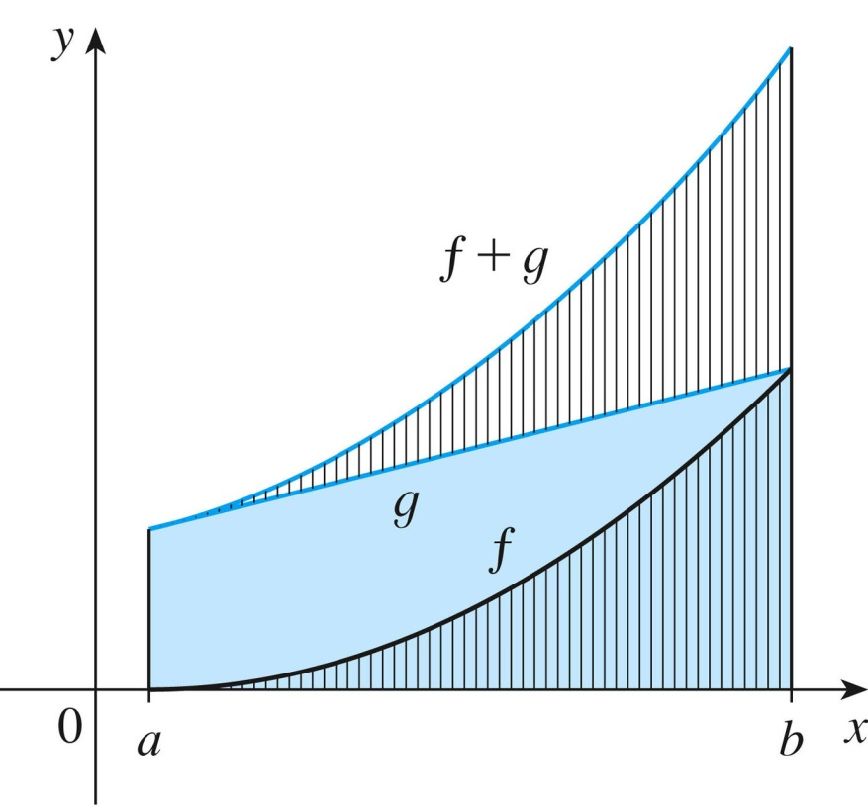
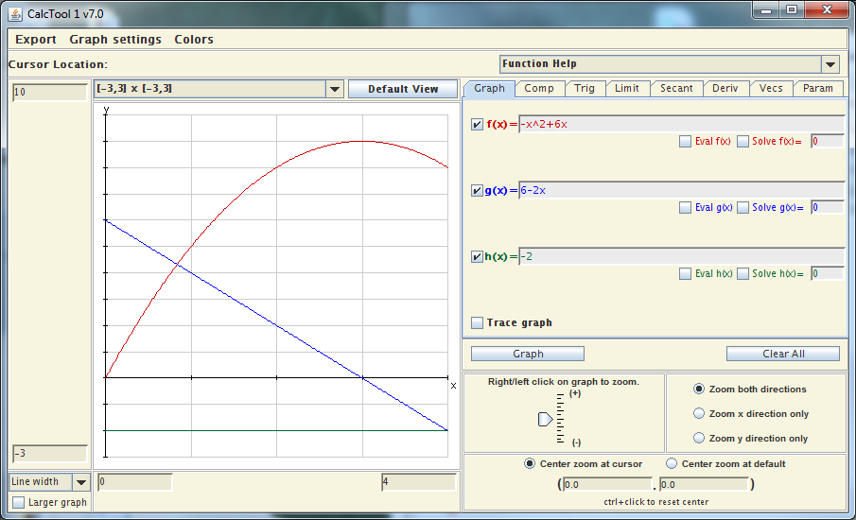
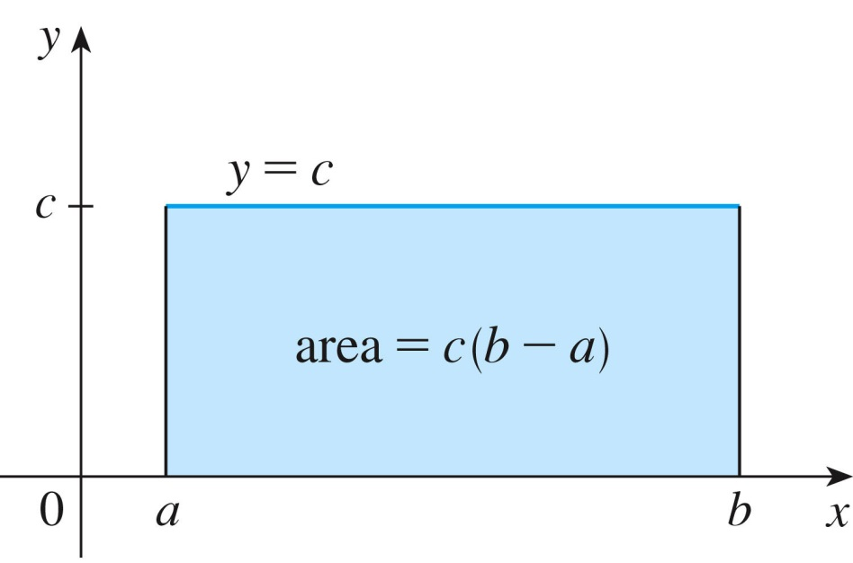
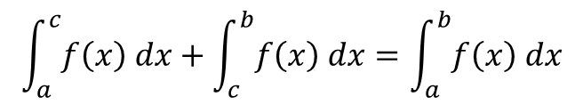
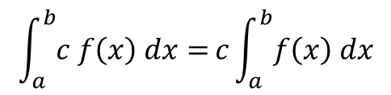
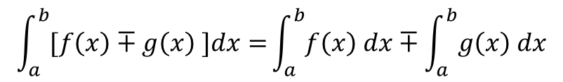
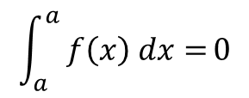
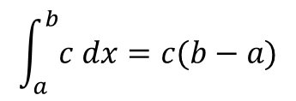
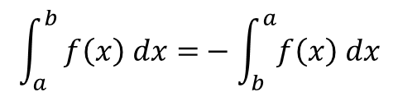
Integral Properties
$$\int_{a}^{b}{[f\left(x\right)∓g\left(x\right) ]dx=}\int_{a}^{b}{f\left(x\right) dx}∓\int_{a}^{b}{g\left(x\right) dx}$$
$$\int_{a}^{b}{c f\left(x\right) dx=}c\int_{a}^{b}{f\left(x\right) dx}$$
$$\int_{a}^{b}{c dx=c(b−a)}$$
$$\int_{a}^{b}{ f\left(x\right) dx=}−\int_{b}^{a}{f\left(x\right) dx}$$
$$\int_{a}^{a}{ f\left(x\right) dx=}0$$
$$\int_{a}^{c}{f\left(x\right) dx}+\int_{c}^{b}{f\left(x\right) dx}=\int_{a}^{b}{f\left(x\right) dx}$$
Notes:
Additive: important in 5.2 #43, plus example-2 on p362

Slide 19
